Slide 1
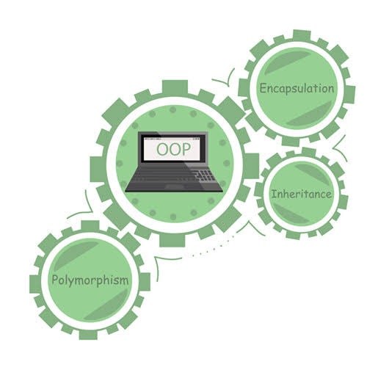

Object Oriented Paradigm
Topic: JAVA
Inheritance

Slide 2


Why do we need Inheritance?
Smart Watch
Classical Watch
SetAlarm()
DisplayDate()
DisplayDate()
DisplayTime()
SetTimer()
DisplayDay()
Light()
DisplayTime()
DisplayDay()

Slide 3
Why do we need Inheritance?
Smart Watch
Classical Watch
DisplayDate()
DisplayDay()
DisplayTime()
Light()
SetTimer()
SetAlarm()
DisplayDate()
DisplayDay()
DisplayTime()

Slide 4
Why do we need Inheritance?
Parent Class
Classical Watch
DisplayDate()
DisplayDay()
DisplayTime()
In real time scenario: You will lose the existence of Classical watch.
Child Class
Only solution is:
inheriting
Smart Watch
Reduces Code Redundancy
Improves Readability
Improves Functionality of Code
Light()
SetTimer()
SetAlarm()

Slide 5
Why do we need Inheritance?
Smart Watch
Classical Watch
Code Redundancy
DisplayDate()
DisplayDay()
DisplayTime()
Light()
SetTimer()
SetAlarm()
Light()
SetTimer()
SetAlarm()
DisplayDate()
DisplayDay()
DisplayTime()

Slide 6
JAVA Inheritance
Inheritance can be defined as the process where one class acquires the properties (methods and fields) of another.
extends is the keyword used to inherit the properties of a class.
class Super {
.....
.....
}
class Sub extends Super {
.....
.....
}

Slide 7
Note:
A subclass inherits all the members (fields, methods, and nested classes) from its superclass.
Constructors are not members, so they are not inherited by subclasses, but the constructor of the superclass can be invoked from the subclass.

Slide 8
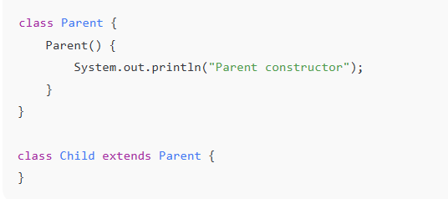


Constructors are not inherited by subclasses
The Parent’s constructor still runs first.
Why? Because Java automatically calls the parent constructor using: super();

Slide 9
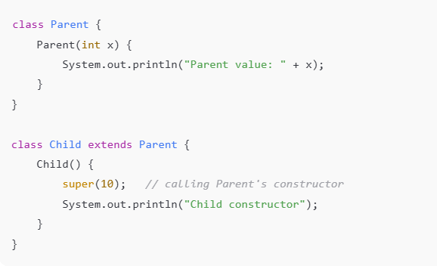

The constructor of the superclass can be invoked from the subclass
A child class can explicitly call the parent’s constructor using super().
Output

Slide 10

Contents - Inheritance
IS-A Relationship
HAS-A Relationship
Single Inheritance
Multi level Inheritance
Hierarchical Inheritance
Hybrid Inheritance
Rules of Inheritance in JAVA

Slide 11

IS-A Relationship
Represents inheritance
One class is a type of another class
Uses keywords like extends (in Java)
A Dog IS-A Animal

Slide 12
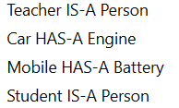
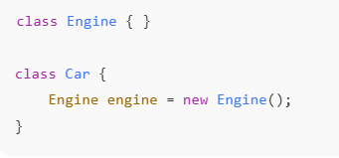
HAS-A Relationship
Represents association / composition
One class contains another class as a part
Uses objects as instance variables
IS-A → inheritance (type relationship)
HAS-A → containment (ownership relationship)
A Car HAS-A Engine

Slide 13
IS-A Relationship
Following are true?
Animal is the superclass of Mammal class.
Animal is the superclass of Reptile class.
Mammal and Reptile are subclasses of Animal class.
Dog is the subclass of both Mammal and Animal classes.
Animal
public class Animal {
}
public class Mammal extends Animal {
}
public class Reptile extends Animal {
}
public class Dog extends Mammal {
}
Mammal
Reptile
Dog
Now, if we consider the IS-A relationship, we can say −
Mammal IS-A Animal
Reptile IS-A Animal
Dog IS-A Mammal
Hence: Dog IS-A Animal as well
With the use of the extends keyword, the subclasses will be able to inherit all the properties of the superclass except for the private properties of the superclass.

Slide 14
Proof: We can assure that Mammal is actually an Animal with the use of the instance operator.
class Animal {
}
class Mammal extends Animal {
}
class Reptile extends Animal {
}
public class Dog extends Mammal {
public static void main(String args[]) {
Animal a = new Animal();
Mammal m = new Mammal();
Dog d = new Dog();
System.out.println(m instanceof Animal);
System.out.println(d instanceof Mammal);
System.out.println(d instanceof Animal);
}
}
Why only Dog is public?
In Java:
Only one public class is allowed per .java file, and the filename must match that public class name.
Other classes are not private, they have default (package-private) access.
Classes without public are visible inside the same package only, not outside.
true
true
true

Slide 15

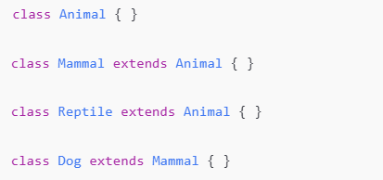
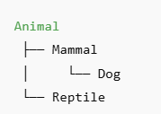
Objects created in main()
What instanceof means
instanceof checks:
Is this object part of this class or any of its parent classes?
Why all outputs are true
m instanceof Animal
m is a Mammal
Mammal extends Animal So Mammal is an Animal → true
d instanceof Mammal
d is a Dog
Dog extends Mammal So Dog is a Mammal → true
d instanceof Animal
Dog → Mammal → Animal So Dog is also an Animal → true

Slide 16

If you wrote:
Output would be false, because not every Animal is a Dog.
Remember: instanceof returns true if the object belongs to that class or any of its parent classes.

Slide 17
HAS – A Relationship
This determines whether a certain class HAS-A certain thing. This relationship helps to reduce duplication of code as well as bugs.
Example:
Class Van HAS-A Speed. By having a separate class for Speed, we do not have to put the entire code that belongs to speed inside the Van class, which makes it possible to reuse the Speed class in multiple applications.
public class Vehicle{}
public class Speed{}
public class Van extends Vehicle {
private Speed sp;
}

Slide 18
Types of Inheritance
4
Inheritance
Hybrid
Inheritance
Single
Inheritance
Hierarchical Inheritance
Multi Level Inheritance

Slide 19
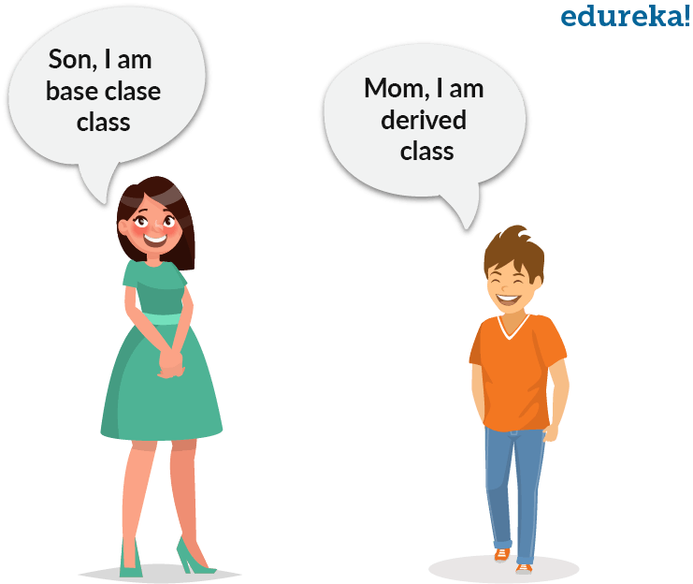
Single Inheritance
Class A
Process where a sub class inherits all the properties and behaviour of a single super class.
Class B
public class A {
------------------ }
public class B extends A {
------------------ }

Slide 20
TestInheritance.java
class Animal{
void eat(){
System.out.println(“eating”);}
}
class Dog extends Animal{
void bark(){
System.out.println(“barking”);}
}
class TestInheritance{
public static void main(String args[]){
Dog d=new Dog();
d.bark();
d.eat();
}
}
1 parent
Class Animal
Class Dog
1 Child

Slide 21
Example
Person
-age : int
-name: string
+setage(int)
+setname(string)
+getage()
+getname()
In another class : empData, create object for employee.
With that object call setname(), setage(), setempID().
Print the same using getage, getname, getID functions.
Employee
-empID : string
+setempID(string)
+getempID()

Slide 22
Person
public class Person{
private int age;
private String name;
public void setage(int ag){
age=ag;
}
public void setname(String nm){
name=nm;
}
public int getage(){
return(age);
}
public String getname(){
return(name);
}
}
-age : int
-name: string
+setage(int)
+setname(string)
+getage()
+getname()
Employee
-empID : string
+setempID(string)
+getempID()

Slide 23
Person
-age : int
-name: string
+setage(int)
+setname(string)
+getage()
+getname()
public class Employee extends Person{
private String empID;
public void setempID(String emp){
empID=emp;
}
public String getempID(){
return(empID);
}
}
Employee
-empID : string
+setempID(string)
+getempID()

Slide 24
public class Person{
private int age;
private String name;
public void setage(int ag){
age=ag;
}
public void setname(String nm){
name=nm;
}
public int getage(){
return(age);
}
public String getname(){
return(name);
}
}
public class Employee extends Person{
private String empID;
public void setempID(String emp){
empID=emp;
}
public String getempID(){
return(empID);
}
}
In another class : empData, create object for employee.
With that object call setname(), setage(), setempID().
Print the same using getage, getname, getID functions.

Slide 25
In another class : empData, create object for employee.
With that object call setname(), setage(), setempID().
Print the same using getage, getname, getID functions.
public class empData{
public static void main (String[] args){
Employee edata = new Employee();
edata.setname(“John”);
edata.setage(46);
edata.setempID(“emp1901”);
System.out.println(“Name:”+edata.getname());
System.out.println(“Age:”+edata.getage());
System.out.println(“Employee ID:”+edata.getempID());
}
}

Slide 26
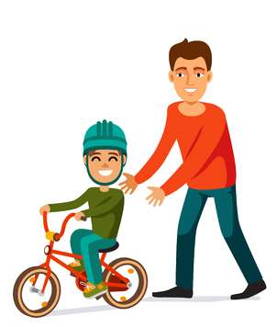

Multi level Inheritance
public class A {
------------------ }
public class B extends A {
------------------ }
public class C extends B {
------------------ }
Class A
Class B
Class C
Process where a sub class inherits all the properties and behaviour of more than one super class at multiple levels.

Slide 27
Hierarchical Inheritance
public class A {
------------------ }
public class B extends A {
------------------ }
public class C extends A {
------------------ }
Class A
Class B
Class C
Class D
Process where one or more sub classes inherit all the properties and behaviours of one super class.

Slide 28
Multi level Inheritance - Example
class Animal{
void eat(){
System.out.println(“eating…”);}
}
class Dog extends Animal{
void bark(){
System.out.println(“barking…”);}
}
class Puppy extends Dog{
void weep(){
System.out.println(“weeping…”);}
}
class TestInheritance2{
public static void main(String args[]){
Puppy d=new Puppy();
d.weep();
d.bark();
d.eat();
}
}

Slide 29
class calculator{
public float mul(float a, float b){
return p*q; }
public float sum(float a, float b){
return p+q; }
public float dif(float a, float b){
return a-b; }
public float div(float a, float b){
return p/q; }
}
class area extends advanced{
public float square(float m){
return m*m; }
public float rectangle(float l, float b){
return l*b; }
public float circle(float r){
return (float) (3.142*r*r); }
}
Public class baseclass{
public static void main(String[] args){
area obj1 = new area();
float result;
result = obj1.sum(10,20);
System.out.println(“Sum:”+ result);
--------------------------------
result = obj1.circle(4);
System.out.println(“Circle Ar:”+ result);
}
class advanced extends calculator{
public float mod(float m, float n){
return m%n; }
public float sqr(float m){
return m*m; }
public float sqrt(float m){
System.out.println(Math.sqrt(m));
return m; }
}

Slide 30
Example
calculator
+float mul (float, float)
+float sum (float, float)
+float dif (float, float)
+float div (float, float)
In another class : baseclass
Create object for area and call all functions and print the output.
advanced
+float mod(float, float)
+float sqr(float)
+float sqrt(float)
area
+float square(float)
+float rectangle(float, float)
+float circle (float)

Slide 31
Example
class Animal{
void eat(){
System.out.println(“eating”);}
}
class Dog extends Animal{
void bark(){
System.out.println(“barking”);}
}
class Cat extends Animal{
void meow (){
System.out.println(“meowing”);}
}
class TestInheritance{
public static void main(String args[]){
Dog d=new Dog();
d.bark();
d.eat();
Cat c=new Cat();
c.meow();
c.eat();
}
}

Slide 32
Hybrid Inheritance
Class A
Combination of one or more inheritances.
Class B
Class C
Multi level Inheritance
Hierarchical Inheritance
Class D
Class E

Slide 33
Rules of Inheritance in JAVA
RULE 1: Multiple Inheritance is NOT permitted in Java.
RULE 2: Cyclic Inheritance is NOT permitted in Java.
RULE 3: Private members do NOT get inherited.
RULE 4: Constructors cannot be Inherited in Java.
RULE 5: In Java, we assign parent reference to child objects.
RULE 6: Constructors get executed because of super() present in the constructor.

Slide 34
THANK YOU….

